Slide 1
COLLEGE CHAT BOT
CAPSTONE PROJECT
Presented By:
1. Boomish-United Institute of Technology-ECE

Slide 2
OUTLINE
Problem Statement (Should not include solution)
Proposed System/Solution
System Development Approach (Technology Used)
Algorithm & Deployment
Result
Conclusion
Future Scope
References

Slide 3
Problem Statement
Create a college admission chatbot helping students with course details, requirements, and application updates. It collects student info like name, phone number, exam rank, interested courses, and intermediate hall ticket number. The bot ensures a smooth experience, guiding students through admission with timely assistance.

Slide 4
Proposed Solution
User Interaction : The chatbot engages users in natural language conversations, using prompts and responses to assist them throughout the admission process.
Information Collection : It requests users to input their full name, mobile number, EAMCET rank, preferred courses, and intermediate hall ticket number, securely storing this data.
Query Handling : The chatbot adeptly addresses inquiries regarding course specifics, admission prerequisites, application status updates, and general college information with precise and relevant responses.
User Guidance : It offers systematic guidance, directing users on how to proceed with their application, including key deadlines and essential documentation.
Feedback Mechanism : The chatbot incorporates a feedback system to enhance its responses and refine user interaction continually, ensuring ongoing improvement and optimal user experience.

Slide 5
System Approach
The "System Approach" section outlines the overall strategy and methodology for developing and implementing the rental bike prediction system. Here's a suggested structure for this section:
System requirements : windows 11 operating system , 8GB RAM, I3 Processor
Library required to build the model : IBM Watsonx assistant

Slide 6
Result
The college admission chatbot is engineered to simplify the application process for prospective students. Through natural interaction, users receive comprehensive guidance on admission procedures, course specifics, and general college details. The bot securely gathers essential user information, including full name, mobile number, exam rank, preferred courses, and hall ticket number. It efficiently addresses user inquiries, delivering precise information and step-by-step instructions. Furthermore, a feedback system facilitates continuous enhancement of the chatbot's functionality and user interaction, ensuring optimal performance and an enhanced overall experience for applicants.

Slide 7
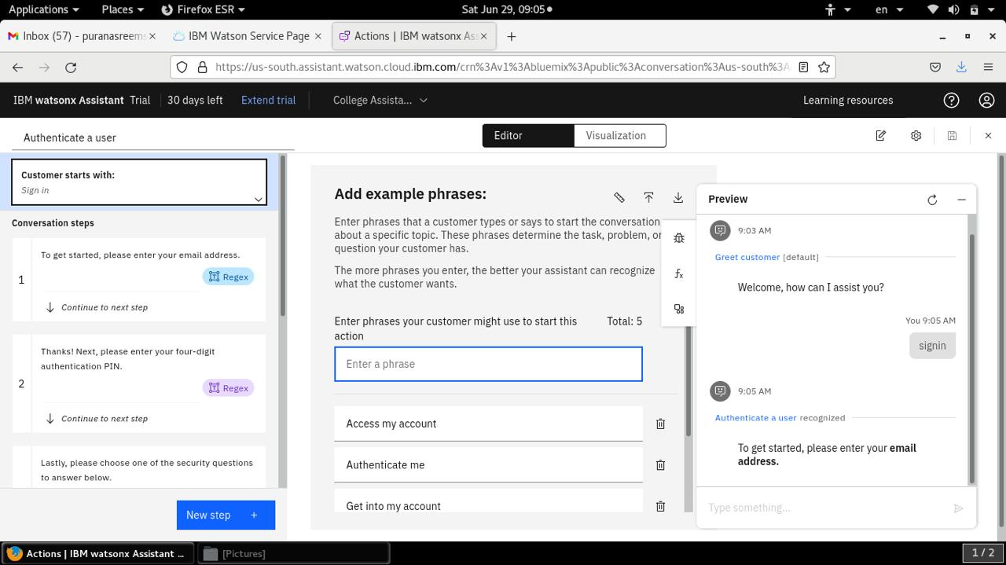
Result

Slide 8
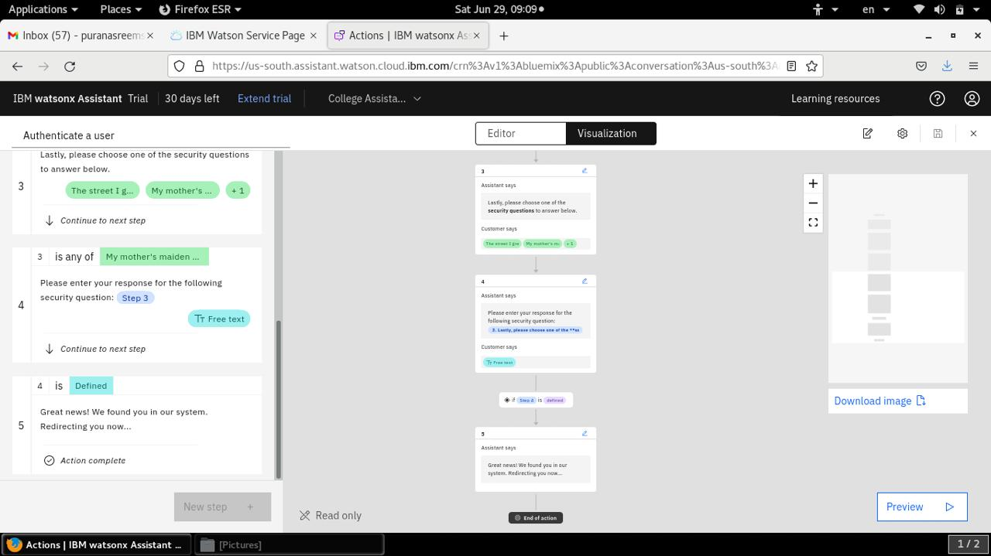
Result

Slide 9
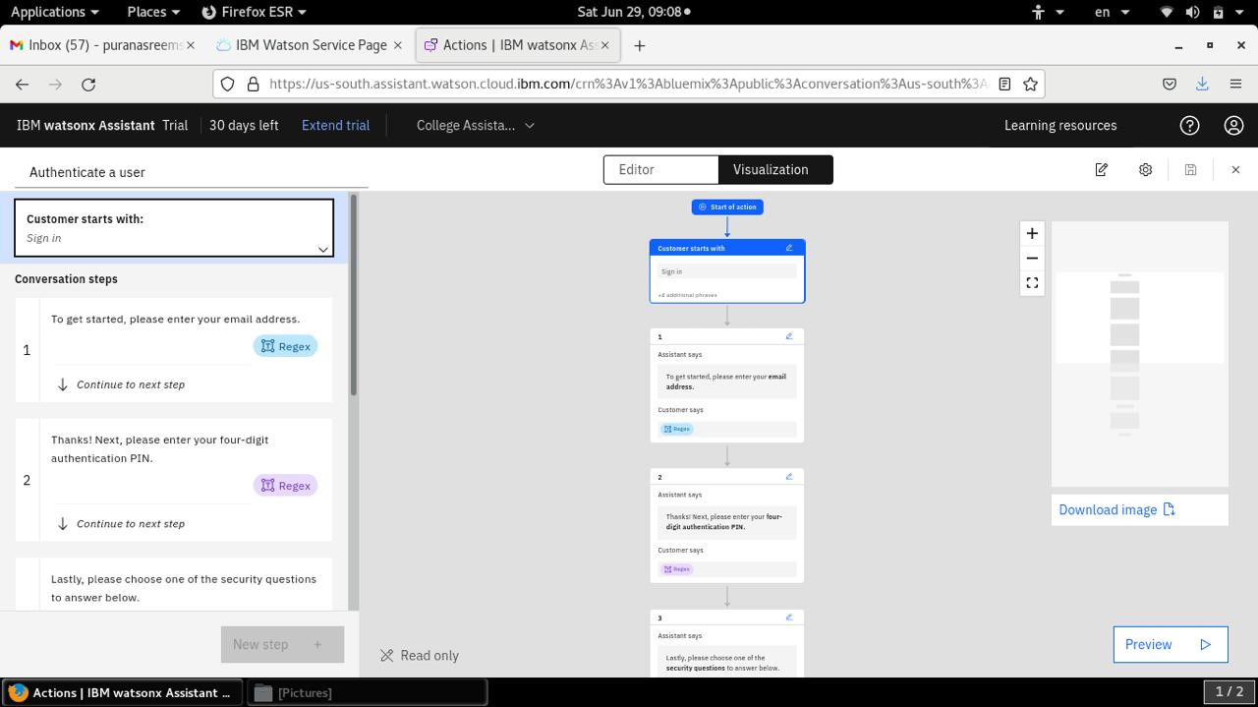
Result

Slide 10
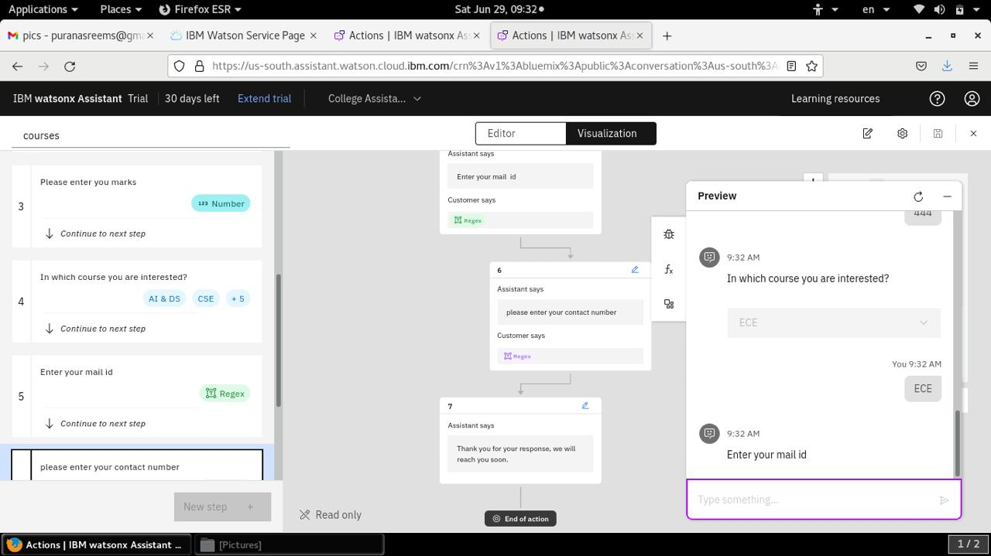
Result

Slide 11
Conclusion
In conclusion, The development of a college admission chatbot represents a pragmatic approach to improving the application journey for prospective students. Utilizing advanced natural language processing and secure data handling, the chatbot adeptly steers users through the admission process, offering precise and timely information. Its intuitive interface and feedback loop facilitate ongoing enhancements, ensuring a user-centric experience that benefits both students and the college administration. In essence, the chatbot streamlines admissions, fostering efficiency and seamlessness throughout the process.

Slide 12
Future scope
Personalized Assistance : By integrating machine learning algorithms, the chatbot can analyze user preferences and behaviors. This enables it to offer tailored recommendations and personalized assistance throughout the admission process.
Multilingual Support : Incorporating language translation features makes the chatbot accessible to a broader audience, including international students. This not only diversifies the applicant pool but also enhances the college's global outreach.
Virtual Tours and Events : Enhancing the chatbot with virtual tour capabilities and event reminders allows prospective students to explore campus facilities and participate in online admission events. This immersive experience enhances engagement and provides valuable insights into campus life.

Slide 13
References
IBM watsonx Assistant tutorial

Slide 14
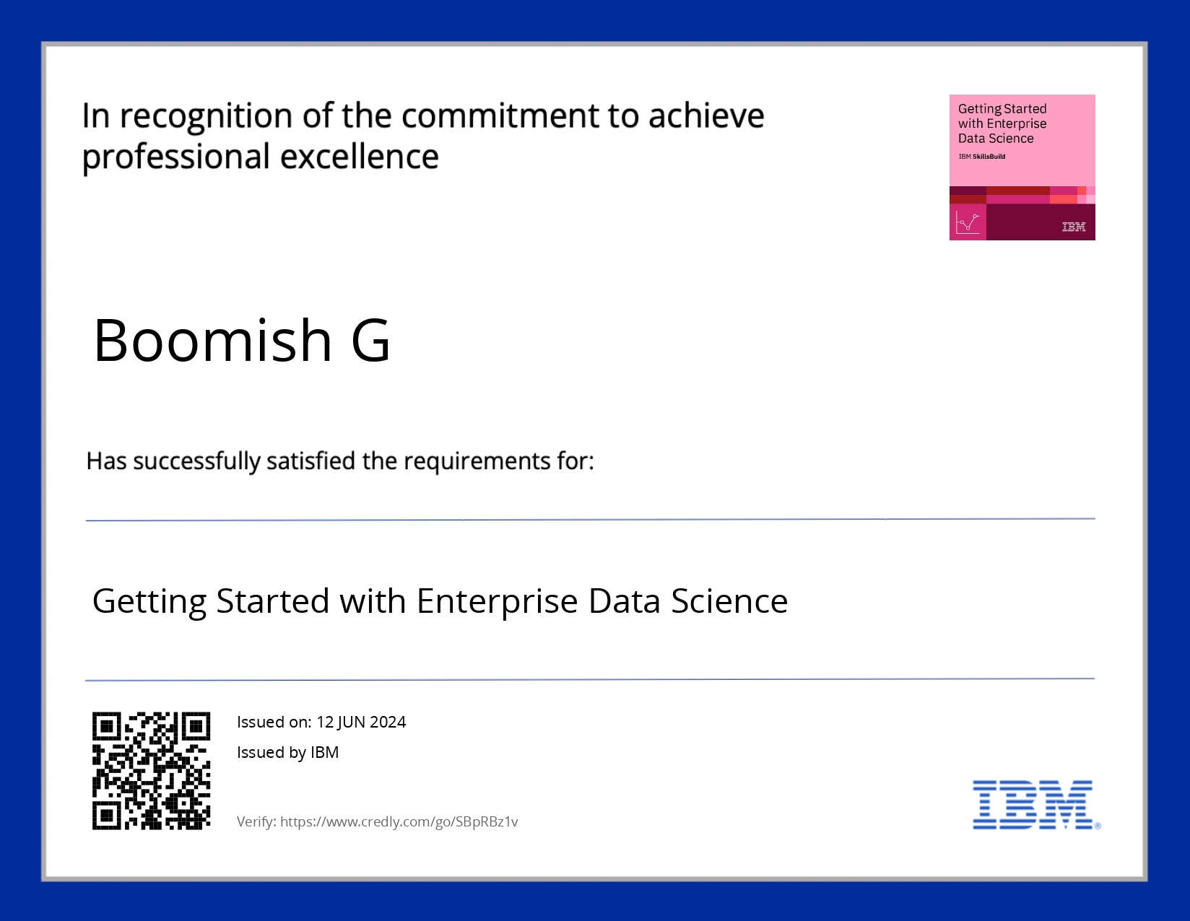
course certificate 1

Slide 15

course certificate 2

Slide 16
THANK YOU

